Slide 1
INTERNATIONAL FINAL PROJECT CONFERENCE
Risking at work? NO, THANKS!
Good practices abroad / Cyprus case
The OiRA implementation
and application
Marios Charalambous
EUROSH Manager

Slide 2
Contents
Existing tools online
New tools
Implementation of the tools
Potential role of the Labour Inspectorates
Planning
Future Developments
Monitoring
Statistics

Slide 3
Existing tools – Online
Hairdressers 2011
Office Work – Public Sector 2012
Butcheries 2014
Catering Services 2014
School Establishments 2015 - 2016

Slide 4
New tools
2016-2017
Development of similar tools for four other sectors:
Small Tourist Lodgings
Restaurants and Coffee Shops
Car Repair and Painting Garages
Small Commercial Shops

Slide 5
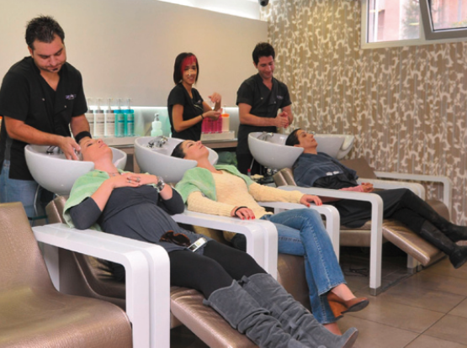
Implementation of the tool
Hairdressers
Presentation of the tool to the members of the Board of the Hairdressers Association.
Presentation of the tool during seminars, organised locally in all Districts, to all members of the Hairdressers Association
for pilot testing,
to convince that the tool is easy to use,
serves their needs,
language used is understandable
the preparation of a risk assessment based on the tool does not take too much time.

Slide 6
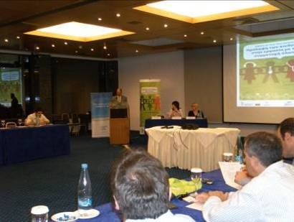
Implementation of the tool
Training on the tool to the Cyprus Hairdressers’ Association inspectors, in order to be able to provide assistance to the hairdressers.
Publication of relevant articles in the Cyprus Hairdressers’ Association magazine in order to raise awareness of the tool among its target end users

Slide 7
Implementation of the tool
Office Work – Public sector
The Department of Labour Inspection with the support and help of the Union of the Civil Servants organised seminars for dissemination of the tool .
Butcheries
The Department of labour inspection with the support of EU-OSHA and the help of the Butchers Association organised seminar for dissemination of the tool .

Slide 8
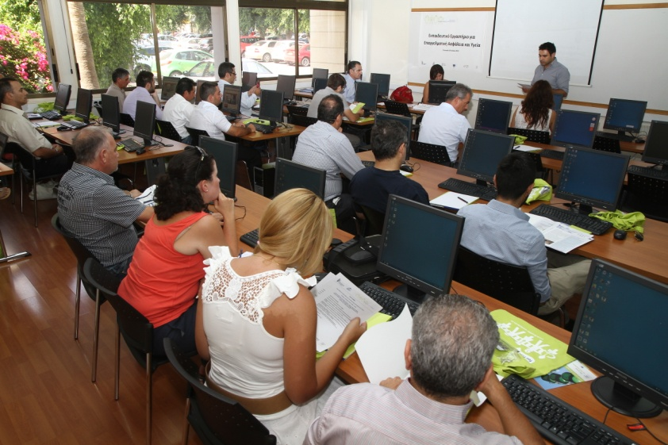
Implementation of the tool
Catering services
The Department with the support of EU-OSHA and the help of the Enterprise Europe Network organised training seminar for the dissemination of the tool .

Slide 9
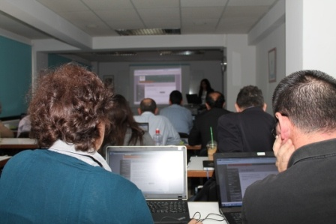
Implementation of the tool
School establishments
The Department with the support of the Ministry of Education and Culture will organise seminars for Pilot Testing of OiRA tool for school Establishments.

Slide 10
Potential role of the
Labour Inspectorates
DLI ensured that all social partners, become aware and involved in the development process from the beginning
Managed to provide simple information easy to transfer to a broader group of users
Provided the users with specific and relevant information as well as guidance on which to base a decision

Slide 11
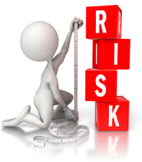
Potential role of the
Labour Inspectorates
Managed to help companies implement the legal requirement on risk assessment
Provided a less resource demanding and effective option, on OSH, for companies
Managed to reach the enterprises with the lowest implementation rate of risk assessment

Slide 12
Potential role of the
Labour Inspectorates
DLI contacted inspection campaigns during 2014 and 2015 to hairdresser salons and barbershops to ascertain whether they have prepared a written risk assessment and to what extent they have used OIRA tool during the preparation of their risk assessments.

Slide 13
Potential role of the
Labour Inspectorates
DLI has also prepared a short questionnaire that was used by Labour Inspectors during the campaign as well as an instruction document given to the employees.
Future Inspection Campaigns for the sectors that OiRA tool has and/or will be developed

Slide 14
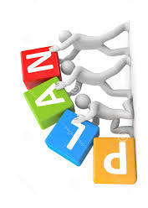
Planning
It is obvious that the problem of a low level of risk assessment implementation in SMEs will not get smaller without some type of intervention.
There are no signs that enforcement activities will be strengthened in the near future
The impact from other initiatives aimed at improving the level of risk assessment implementation, such as guides and checklists

Slide 15
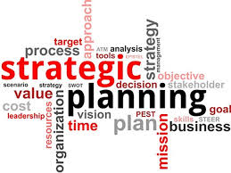
Planning
All economic activities where OiRA tool was and/or will be developed, to be included in the DLI`s Annual Inspection Program
Organisations that provide training to Safety Officers will be asked to include information and training about OiRA to their program`s participants
Reference to OiRA tool during all training programs for Safety Committee members

Slide 16
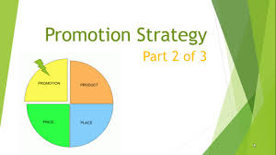
Future Developments
Development of promotion strategies for each single tool along with OiRA promotion materials
The OiRA promotion strategies along with the OiRA promotion materials will be developed using as a basis the OiRA promotion/supporting documents, produced by EU-OSHA and the national OiRA partners available on the OiRA website

Slide 17
Future Developments
Involvement of the sectoral social partners, stakeholders and associations from the very beginning to make sure they are engaged throughout the implementation process
Proposal, the OiRA tool to contain the top occupational risks in the sector.
This makes it possible for users to see clearly the ‘priority risks’ in their company, in addition to the ‘other risks’. In this way the OiRA tool will give users a good focus and put them in the position to find successful solutions to these risks in particular.

Slide 18
Future Developments
EU-OSHA will prepare banners to be used by the sectoral social partners for their websites.

Slide 19
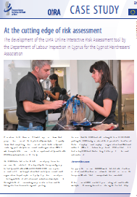
Future Developments
Preparation of articles to be published in media channels specific to each sector, to raise awareness of the tool among its target end-users
Preparation of flyers for each of the OiRA tools which will include general information on the benefits of the tools, together with instructions on the use of the tools, to be distributed to all end-users

Slide 20
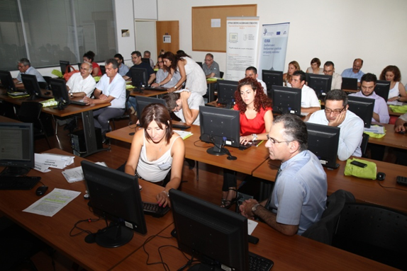
Future Developments
Training of the OiRA tools to specific individuals who will be involved in promoting awareness of the OiRA tools, as identified by each social partner.

Slide 21
Future Developments
Individuals who received the above mentioned training to be key participants in promotion seminars to be organised by stakeholders or social partners.
The participation of the individuals will provide added value in promoting the OiRA tools, as they will be able to address any concerns or queries which may be raised by the end-users

Slide 22
Future Developments
Organisation of a workshop by stakeholders or social partners, for the end-users who have expressed an interest in using the OiRA tools.
Obtain feedback from the workshop and prepare a summary of the relevant findings, to be shared with the stakeholders for distribution to the end-users.

Slide 23
Future Developments
Social partners, stakeholders, associations to set key performance indicators related to the goals in order to evaluate the results and re-adjust the strategy if and where necessary.
Promotion of good practices

Slide 24
Future Developments
‘’ We can’t change the wind but
we can adjust the sails’’

Slide 25
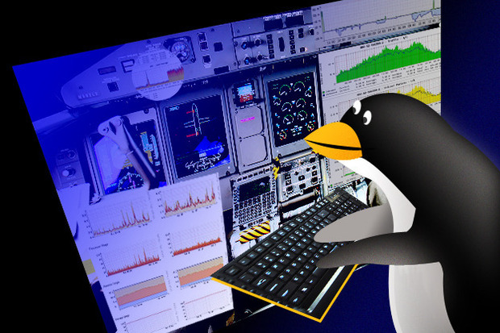
Monitoring
A mechanism/system to record the progress toward achieving the targets
Reporting at prescribed time intervals or when necessary in numbers if possible
To compare sectors/enterprise conformity levels
To evaluate the statistics and conclude on the trends
No rule exists what to monitor, definitely the targets.

Slide 26
Statistics
Risk identification
Most Unanswered/Postponed Risks
Top assessments – survey responses

Slide 27
THANK YOU
HVALA

